Slide 1
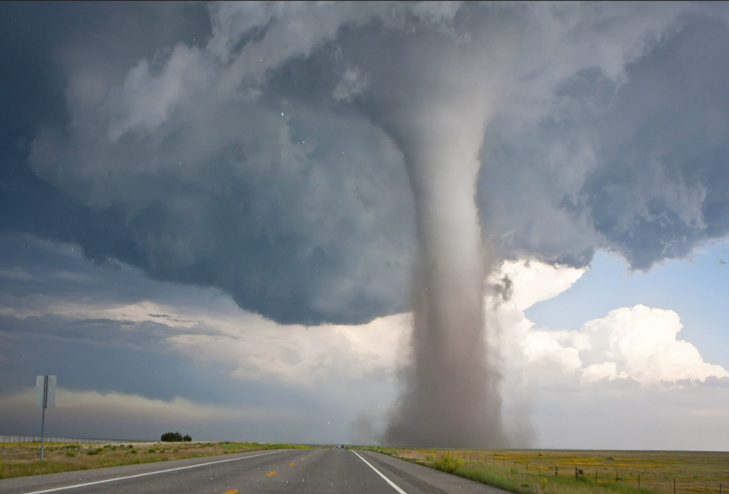
Tornado ALLEY & IT’S SHIFT Over TIME
By Sangeetha Sasikumar,
GeoComputation 1,
Final Presentation
Source: American Museum of Natural History

Slide 2
What Is a Tornado?
According to the National Weather Service “A tornado is a violently rotating column of air extending from the base of a thunderstorm down to the ground”
They are measured from F0 to F5, F5 being the highest (Fujita scale). Lately they are measured using “EF” which is the Enhanced Fujita Scale.
Fun Fact: Studies say Songbirds can hear tornadoes long before they form.

Slide 3
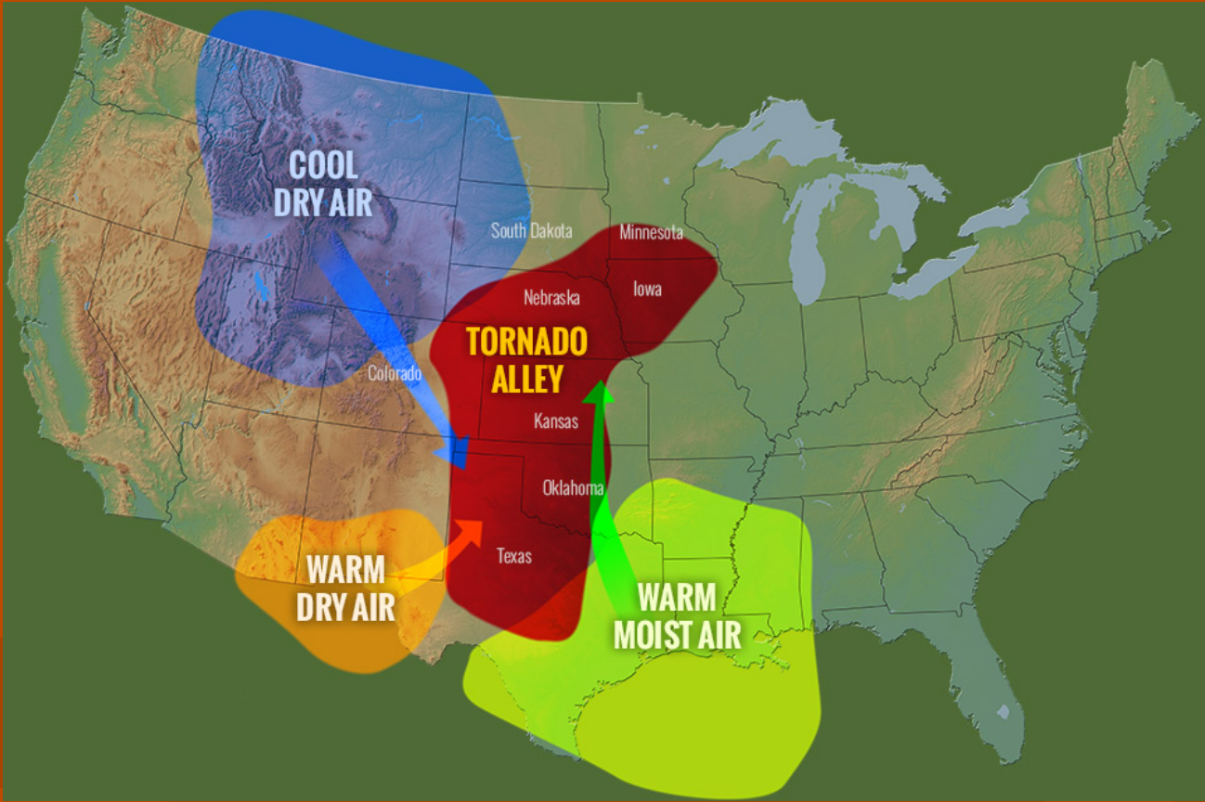
How Does a tornado Form?

Slide 4
Research Questions & HYPOTHESIS
How has the “tornado alley” location changed throughout the decades?
Are there tornadoes appearing more frequently currently than years ago?
I hypothesize that tornado alley has shifted southeast to its usual location, and I do predict an increase in tornadoes during recent years. My hypothesis is an educated guess based on recent occurrences I have seen on the news.

Slide 5
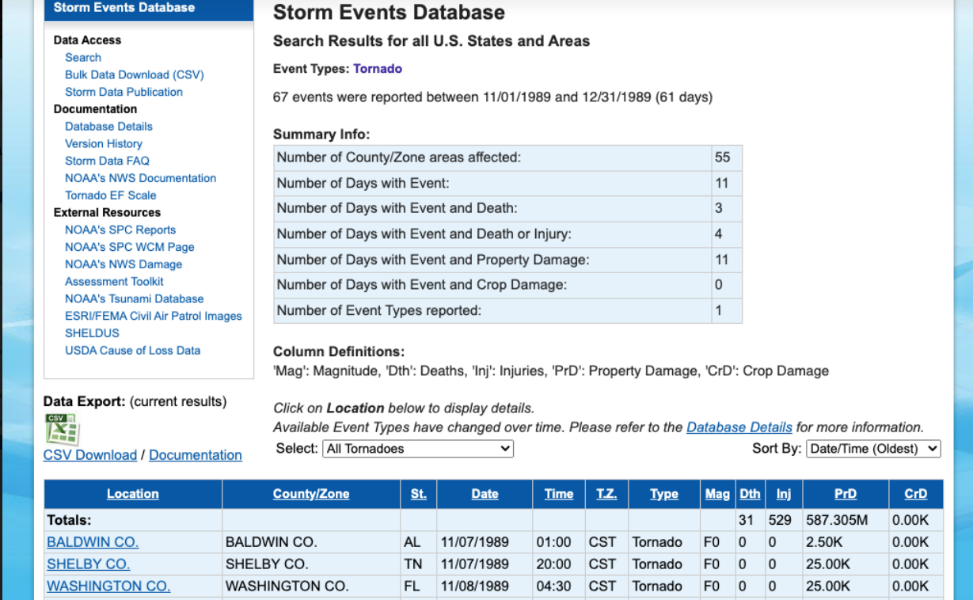
Data Source & Method Used
National Oceanic and Atmospheric Administration, National Centers for Environmental Information’s Storm Events Database
Plotly was used with Python to create the heatmap, the maps are displayed with a mapbox style called “carto-darkmatter”
Matplotlib was used for the bar graph

Slide 6
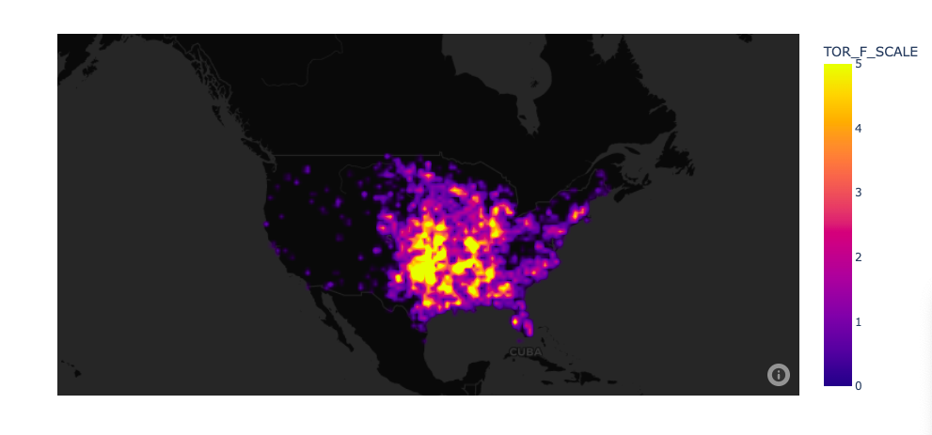
Scale
1950s map shown

Slide 7
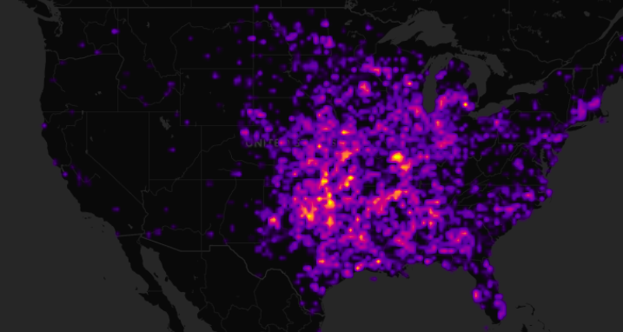
1950s

Slide 8
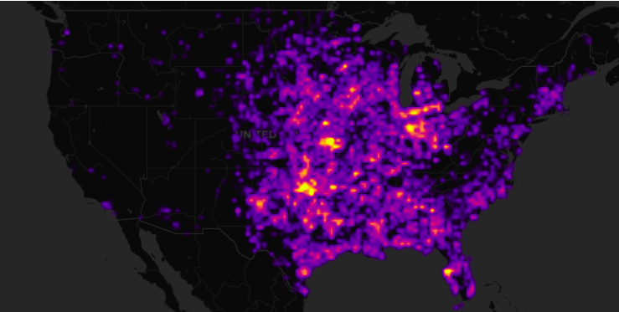
1960s

Slide 9
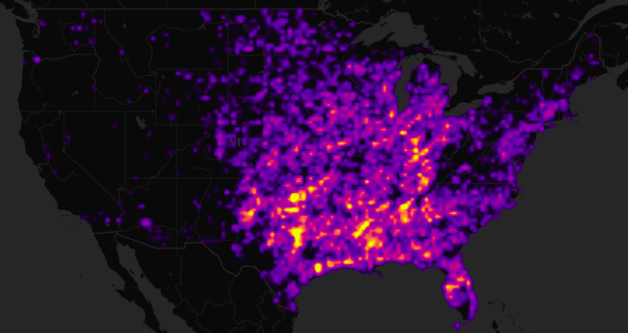
1970s

Slide 10
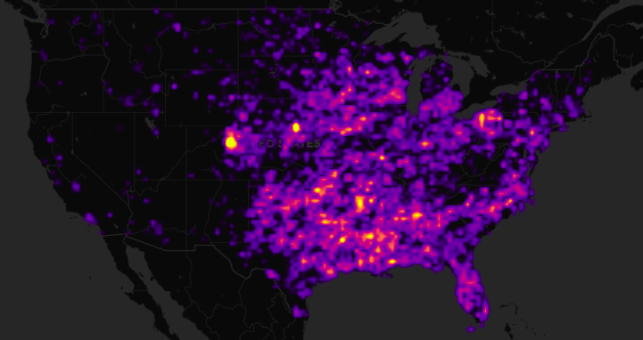
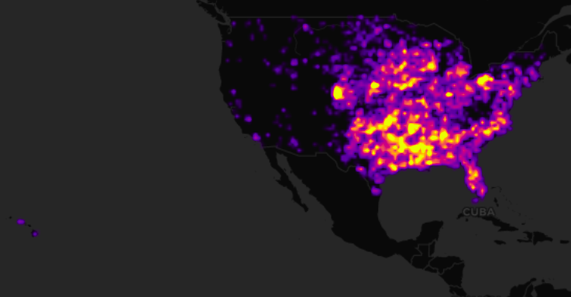
1980s

Slide 11
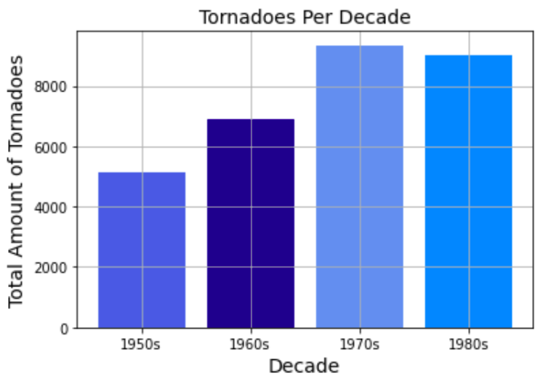
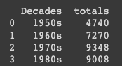
Conclusion
1950s
1960s
1970s
1980s

Slide 12
Challenges Faced
Not using an actual IDE (I used colab), since my python didn’t allow an update or didn’t want to import plotly and other libraries used.
Having csv files with different amounts of columns
Getting COVID!!
Source: The New York Times

Slide 13
Sources
Image Credits:
© Greg Henshall/FEMA; Image Courtesy of The Field Museum; Photo by Michael Raphael/FEMA; Image courtesy of NOAA.
https://www.amnh.org/explore/ology/earth/tornadoes-spinning-thunderstorms
https://www.ncdc.noaa.gov/stormevents/
https://plotly.com/python/mapbox-density-heatmaps/
https://www.theatlantic.com/technology/archive/2014/12/birds-can-hear-tornadoes-coming-long-before-they-form/383898/

